Slide 1
Power Domains – IR Analysis

Slide 2
Goals
ON Steady-state Power and IR Analysis
Analyze how the insertion of power switches impacts power and IR drop when then the switches are in steady ON state
Static or dynamic power can be used to do steady state analysis
OFF Steady-state Power Analysis
Analyze the total power saving and leakage when power switches are turned OFF
Power-up Analysis
Analyze the time required to turn ON all the power gates
Rush Current Analysis
Analyze the impact of rush current generated by the powering up logic on the AON power-grid voltage
Notes:
.

Slide 3
Steady State Analysis

Slide 4
Steps Involved for Steady State Analysis
A. Read the physical design and SPEF file
Read Innovus design which is the output of P&R
Generate SPEF file from P&R
B. Power Grid Library Generation
Used to create and modify a cell library database of PG views
Creates a binary power-grid view of the cells and the technology libraries
Collaterals needed: Technology LEF, cell LEF, Extraction file, Layer maps
Notes:
.

Slide 5
Steps Involved for Steady State Analysis
C. Power Gate Library Characterization
Used to characterize the power switch’s on-resistance, leakage current when the power-gate is OFF and the saturation current
This information is needed for IR drop analysis
Collaterals needed: Technology LEF, cell LEF, Extraction file, Layer maps, SPICE netlist and SPICE device models
D. Power Grid Information
VDD/GND Net names
VDD Supply Voltage
VDD/GND Threshold
Minimum allowed voltage on the power net or maximum rise on the ground net
Threshold value is used to verify that the power grid passed the limit check
Notes:
.

Slide 6
Steps Involved for Steady State Analysis
E. Voltage Source Information
Voltage source information can be specified by pad cells, power pins or by {X,Y} coordinates of the pad cells
F. Power Data
Provide power profile of the design
Notes:
.

Slide 7
Specifications
Parameter | Current Setup | Required Setup
Voltage | 0.72 V | 0.72 V
PVT | SS_0.72_-40C | TT?
Power Profile (for ON power analysis) | Default activities | ?
Power Profile (for OFF power analysis) | Default activities | ?
Voltage Source | Determined by power pins | Determined by bump locations
Notes:
.

Slide 8
Power Switch Analysis
Power gate transistor is modeled as a linear resistance
Value is determined from the device model
Impact of this resistance is modeled during static or dynamic power and rail analysis to ensure that sufficient switches are added in the design to satisfy the current requirement of the switched block
Each switch is checked if it is operating in the non-saturated (linear resistance) region
PASS: Switch is operating in linear resistance region
FAIL: A switch is operating outside of the non-saturation region and drawing too much current
Notes:
.

Slide 9
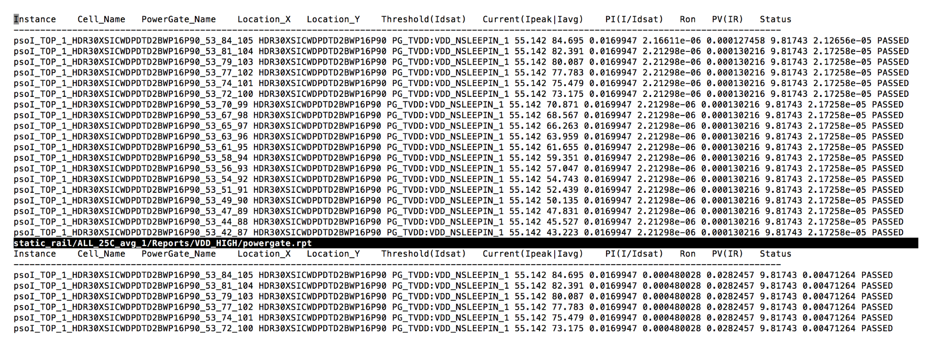
Power Switch Analysis
Analysis at some high activity
Analysis at some low activity
Notes:
.

Slide 10
Power Switch Density Calculation
Operating Voltage =Vdd
Acceptable Voltage Drop (off-chip, package, on-chip etc) = ⍺Vdd
% of acceptable voltage drop on-chip (PG, switches etc.) = β(⍺Vdd)
Acceptable voltage drop across switches = ɣβ(⍺Vdd)
Power of the block (from P&R) = P mW
Current through block=P/Vdd mA
Acceptable resistance across the power switches = ɣβ(⍺Vdd*Vdd)/P Ω
Resistance of power switch = R Ω
No. of power switches = (R*P)/(ɣ β(⍺Vdd*Vdd))
Usually these values are ⍺=10%, β= 30%, assume ɣ= 50%,
So for Vdd=0.72 V, the acceptable drop comes to about 10.8 mV
Notes:
.

Slide 11
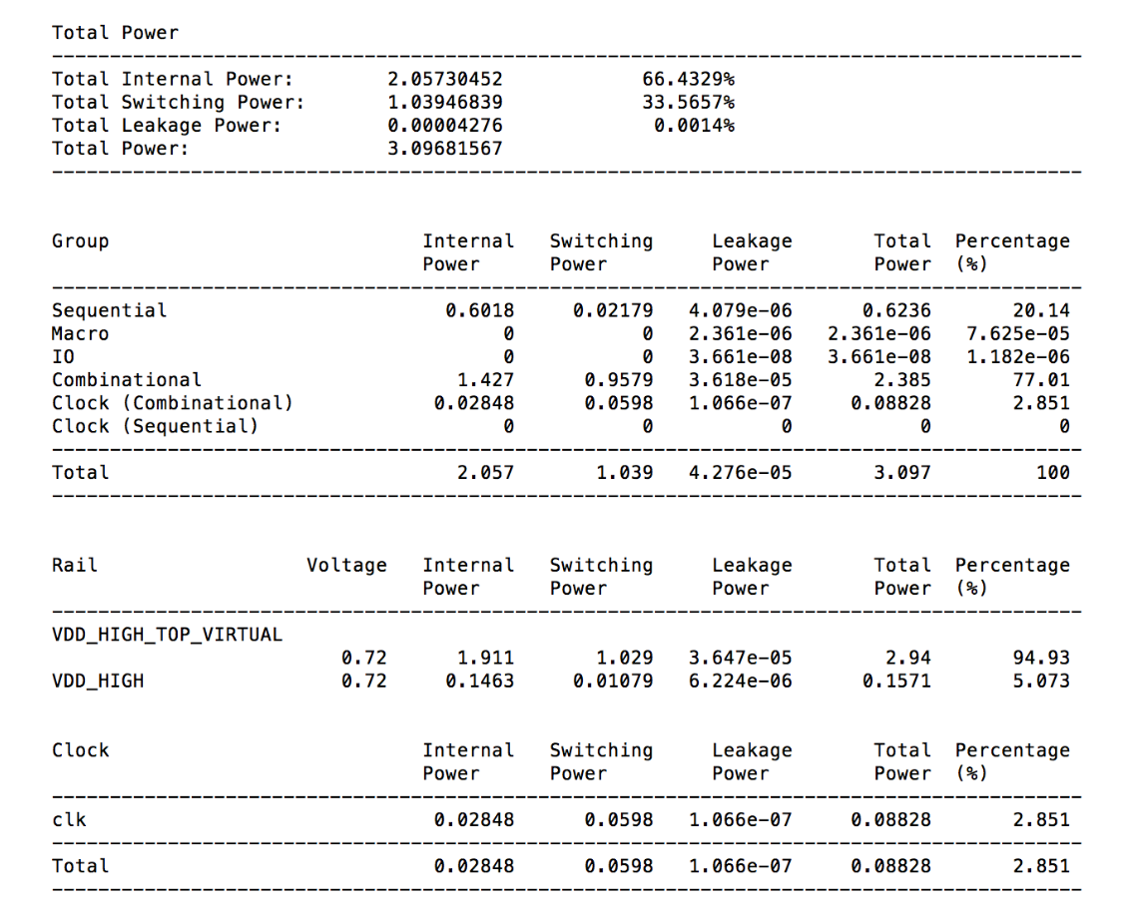
Power when tile is ON (Approx. power profile)
Notes:
.

Slide 12
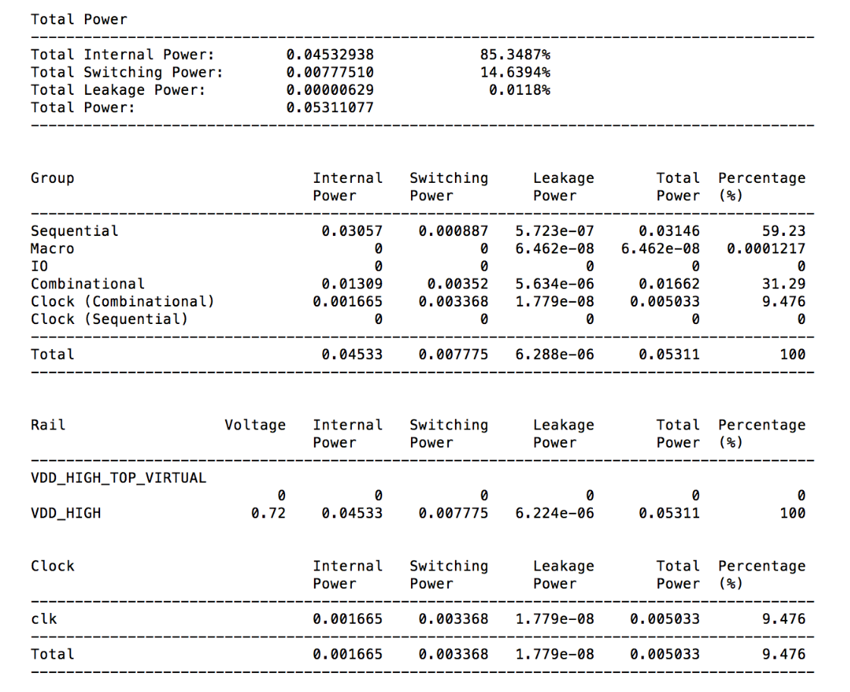
Power after turning off the tile (Approx. power profile)
Notes:
.

Slide 13
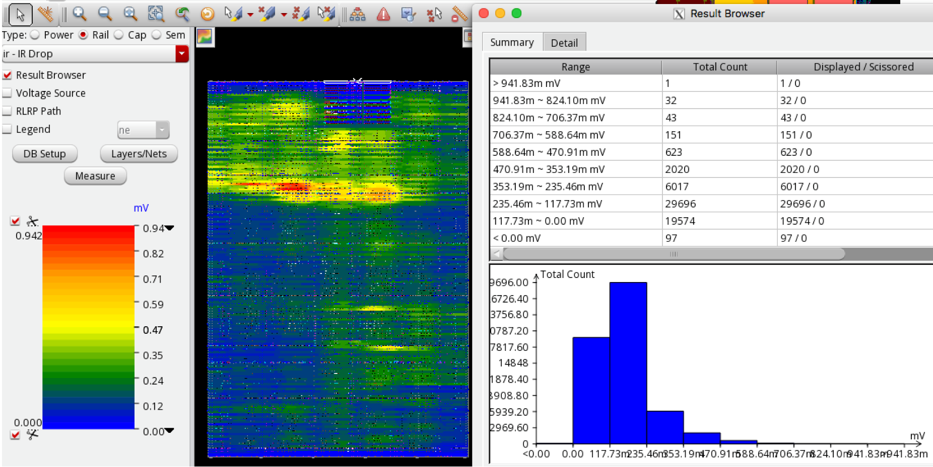
PG IR voltage drop
Notes:
.

Slide 14
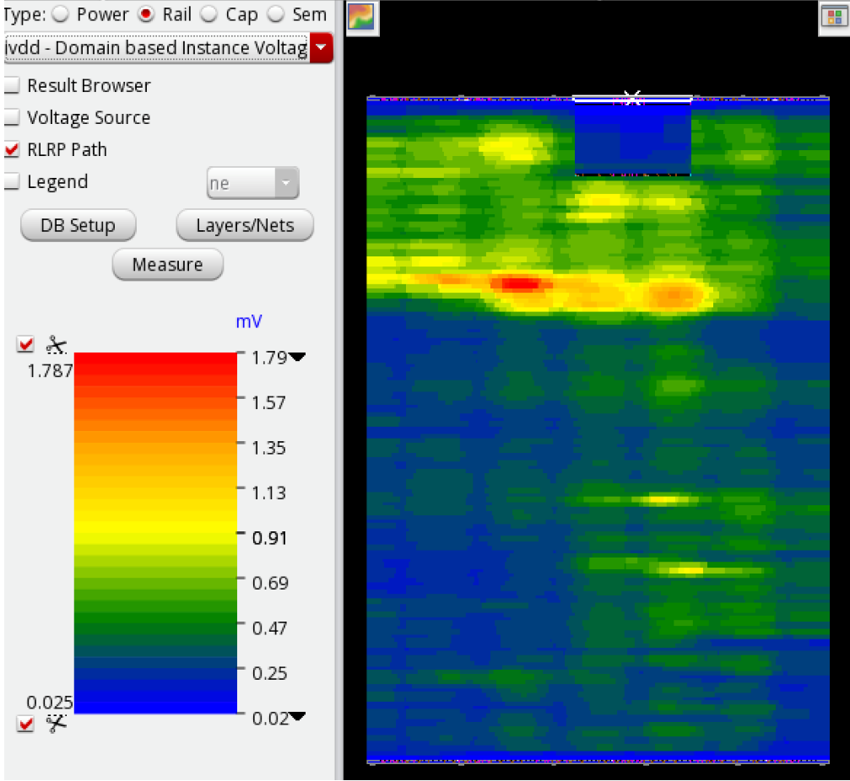
Instance based voltage drop
Notes:
.

Slide 15
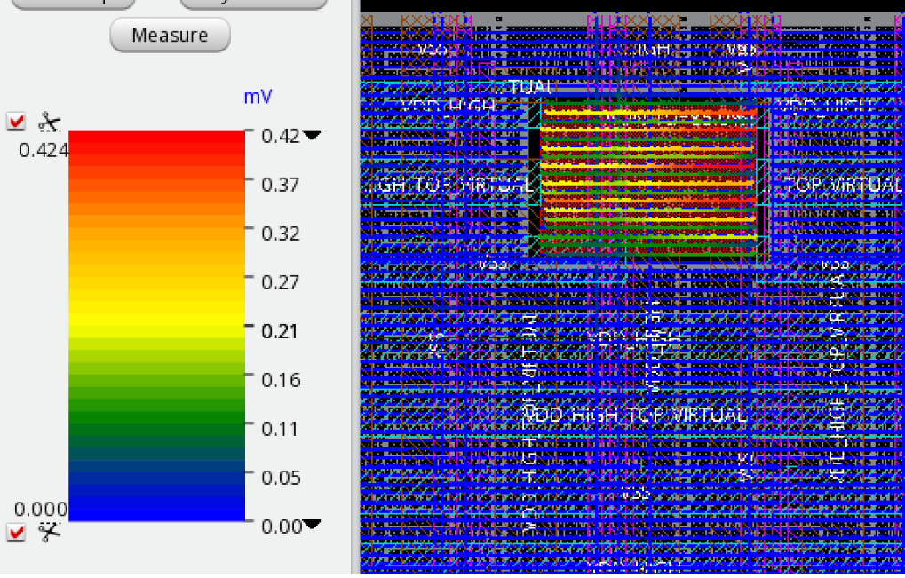
AON IR drop when tile is OFF
Notes:
.

Slide 16
Functional Verification

Slide 17
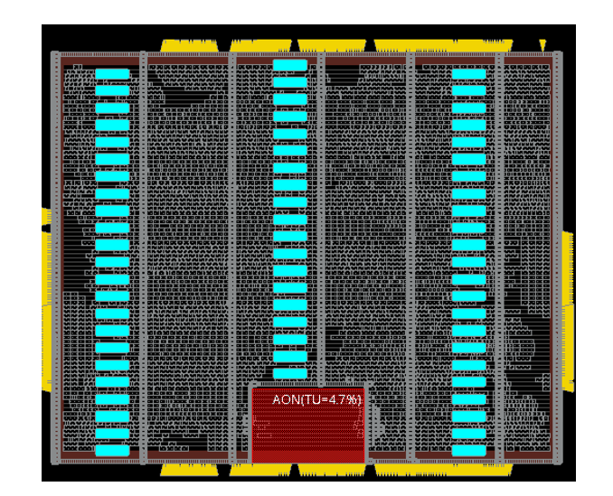
AON – SD Partitioning

Slide 18
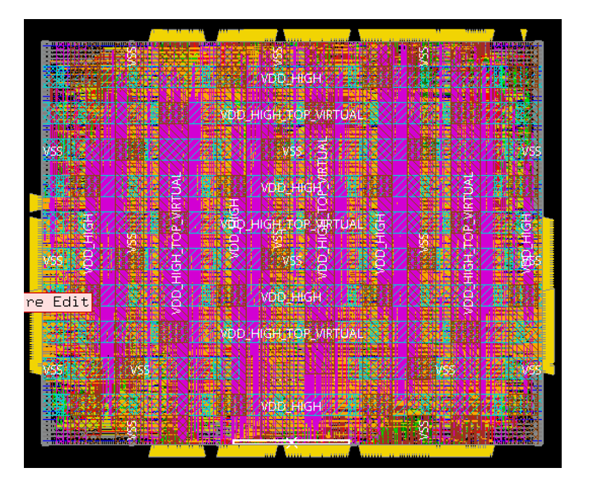
Layout

Slide 19
IR Flow
Determine if power switch count is sufficient
Determine if power grid density is sufficient
Check if IR drop on all cells is within threshold
Review Memory vs PE PS/PG grid density requirement (Any special requirements for Mem?)

Slide 20
PG Aware Power and Timing Analysis
Wakeup time evaluation for the power switches
Faster wakeup time good for timing, but high inrush current causing high IR drop
Daisychaining good for inrush current – but need to verify the wakeup times
Timing closure – No significant performance degradation
Hold time analysis
Review Memory vs PE Timing Analysis (Any special requirements for Mem?)
Power saving evaluations

Slide 21

Questions?

